Slide 1
Chapter 4
History and Evolution of Health Care Information Systems

Slide 2
Learning Objectives
Describe the history and evolution of health care information systems from the 1960s to the present.
Identify the major advances in information technology and significant federal initiatives that influenced the adoption of health care information systems.
Identify the major types of administrative and clinical information systems used in health care.

Slide 3
Outline
Definition of Terms
Information systems & technology
Health care information systems
Administrative applications
Clinical applications
History and Evolution of HCIS (from 1960s until now)
Health care environment
State of information technology
State of health care information systems

Slide 4
Definitions
Information system—an arrangement of—
Data
Processes
People
Technology
that interact to collect, process, store, and provide as output the information needed to support the organization.

Slide 5
Health Care Information System
Administrative information system
Contains primarily administrative or financial data
Used to support the management functions and general operations of the health care organization
Clinical information system
Contains clinical or health-related information relevant to the provider in diagnosing, treating and monitoring the patient’s care

Slide 6
Examples of Administrative Applications
Patient administration systems
Admission, Discharge, and Transfer Registration
Scheduling
Patient billing or accounts receivable
Utilization management
Financial management systems
Accounts payable
General ledger
Personnel management
Materials management
Payroll
Staff Scheduling

Slide 7
Examples of Clinical Applications
Ancillary information systems
Laboratory
Radiology
Pharmacy
Other clinical information systems
Nursing documentation
Electronic medical record (EMR)
Computerized provider order entry (CPOE)
Telemedicine and telehealth
Rehabilitation service documentation
Medication administration

Slide 8
History of HCIS
What was happening in the health care environment and at the federal level that influenced organizations to adopt or use computerized systems?
What was the state of information technology at the time?
How did the environmental factors, coupled with advances in information technology, affect the adoption and use of HCISs?

Slide 9
History of HCIS
What was happening in the health care environment and at the federal level that influenced organizations to adopt or use computerized systems?
What was the state of information technology at the time?
How did the environmental factors, coupled with advances in information technology, affect the adoption and use of HCISs?

Slide 10
In other words,
Health care environment
+
State of information technology
=
Use of health care information systems

Slide 11
1960s-- Billing is the Center of the Universe
Health Care Environment
Enactment of Medicare & Medicaid
Cost-based reimbursement
Building mode
Focus on financial needs and capturing revenues
State of Information Technology
Mainframe computers
Centralized processing
Few vendor-developed products

Slide 12
1960s HCIS
Administrative and financial systems
Used primarily in large hospitals and academic medical centers
Developed and maintained in-house
Shared systems available to smaller hospitals
Data processing was primarily centralized on mainframe computers

Slide 13
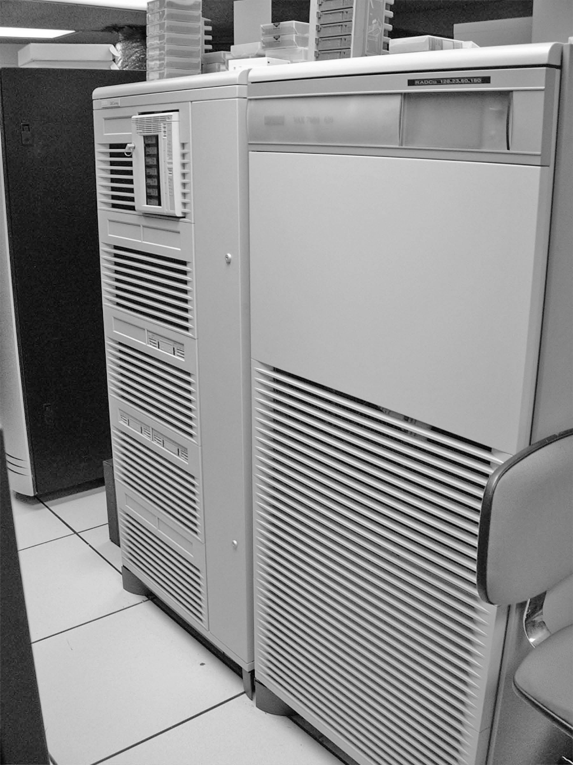
Picture of Mainframe

Slide 14
1970s—Clinical Department Wake Up; Debut of Minicomputer
Health Care Environment
Time of hospital growth and expansion
Medicare and Medicaid expenditures rising
Need to contain health care costs
State of Information Technology
Mainframes still in use
Minicomputers become available, smaller and more affordable

Slide 15
1970s HCIS
Turnkey systems available through vendor community
Increased interest in clinical applications (particularly in ancillary departments)
Shared systems still used

Slide 16
1980s—Computers for the Masses
Health Care Environment
Medicare introduces prospective payment system for hospitals
Medicaid and other private insurers follow suit
Need for financial and clinical information
State of Information Technology
Unveiling of the microcomputer (PC)
Advent of local area network

Slide 17
1980s HCISs
Distributed data processing
Expansion of clinical information systems in hospitals
Physician practices introduce billing systems
Affordable, powerful computers now available to smaller organizations
Ability to integrate financial and clinical information becomes increasingly important

Slide 18
1990s—Health Care Reform; Advent of Internet
Health Care Environment
Medicare changes in physician reimbursement
Health care reform efforts of Clinton administration
Growth of managed care and integrated delivery systems
IOM calls for adoption of computer-based patient record

Slide 19
1990s continued
State of Information Technology
Unveiling of the Internet (World Wide Web)
Internet revolutionizes how organizations communicate with each other, market services, conduct business
Cost of hardware drops

Slide 20
1990s continued
Health Care Information Systems
Health care organizations take advantage of Internet
Vendor community explodes
Wide range of HCIS products/services available
Growing interest in clinical applications
Still relatively small growth in adoption of CPR/EMR systems

Slide 21
2000s: Health Care IT Arrives; Patients Take Center Stage
Health Care Environment
IOM reports on patient safety and medical errors
HHS calls for standards for EHRs
Spiraling health care costs
Economic upheaval and growing number of uninsured
Health care transparency and pay for performance
New administration
Federal stimulus money available for HIT

Slide 22
2000s continued
State of Information Technology
Internet use moves to new level
Voice recognition rebounds
Bar coding and RFID
PDAs and multipurpose cell phones
PHRs and consumers maintaining Web-based records
Web 2.0 technologies

Slide 23
2000s continued
Health Care Information Systems
National call for EHR adoption
Infusion of HIT funding
Office of the National Coordinator for HIT (ONC)
Regional health information organizations
Health care organizations struggle with how to successfully implement point of care clinical systems
CPOE
EHR
E-prescribing

Slide 24
2010 and Beyond
An Era of Accountability, Transparency and Change--Affordable Care Act, Meaningful Use and ICD-10 All Kick In

Slide 25
2010+
Health Care Environment
Passage of Affordable Care Act
HITECH Act
Increased accountability
Health insurance reform including new payment models

Slide 26
2010+
Information Technologies
Cloud computing
Mobile applications
Social Communication
Next Generation Analytics

Slide 27
Summary
Challenges of health care environment, coupled with advances in information technology, led to state of health care information systems
Important to look at where health care industry has come in its adoption and use of IT and where it has yet to go

