Slide 1
Chapter Nine
Technologies that Support Health Care Information Systems

Slide 2
Learning Objectives
Gain a basic understanding of the core technologies behind health care information systems that support:
Data management and access
Networks
Information distribution schemes
Remote access technologies
Internet and web concepts and applications
Clinical and managerial decision support
Electronic and mobile commerce
Discuss emerging trends in information technology and the Gartner Hype Cycle
Identify some of the major issues in the adoption of information technologies in health care organizations.
Discuss why it is important for a health care organization to adopt an overall information systems architecture.

Slide 3
Outline
Information Technology Adoption Challenges
Core Technologies
Data Management and Access
Networks and Data Communications
Information Distribution Schemes
Remote Access Technologies
Internet and Web Concepts and Applications
E-Commerce in Health Care
Clinical and Managerial Decision Support
Information Systems Architecture

Slide 4
Information Technology Adoption Challenges
How does a health care executive know when to support the adoption of the “latest and greatest” technologies?
When does the organization acknowledge its current technologies are out-of-date and need upgrading?
How much of the current literature about new technologies is “hype?”
Which new technologies are likely to survive to become industry standards?
At what point should the health care executives have known that these technologies were here to stay and were something to be managed?
Do the early adopters of the technologies have an advantage or a disadvantage in the market?

Slide 5
Gartner Hype Cycle (Gartner 2012)
Technology Trigger..
Peak of Inflated Expectations.
Trough of Disillusionment.
Slope of Enlightenment.
Plateau of Productivity.

Slide 6
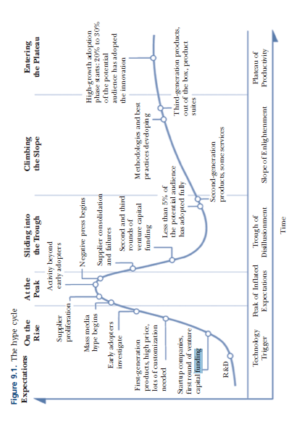
Gartner Hype Cycle (Gartner 2012)

Slide 7
Data Management and Access
Database Models
Database Operations
Databases on the Web
Clinical Data Repositories, data warehouses and data marts
Data mining

Slide 8
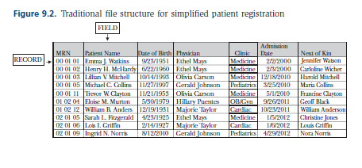
Database Models
Traditional “Flat” File Structure

Slide 9
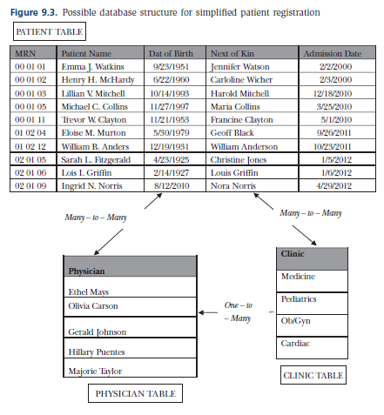
Database Models
Relational Database Structure (simplified)

Slide 10
Database Operations
Most common programming language in relational databases is Structured Query Language
The following example of a simple SQL statement would return a list of Dr. Ethel Mays’s patients from the simplified patient registration database
SELECT PATIENT, PHYSICIAN FROM PATIENTS
WHERE PHYSICIAN = ‘Ethel Mays’

Slide 11
Database Operations
Schema—the actual structure of the database
Data dictionary—repository of information about the database
Metadata—equivalent to Data Dictionary

Slide 12
Data Dictionary
Data Definitions are critical to quality data
Typical Data Dictionary elements
Table names
All attribute or field names
A description or definition of each data element
The data type of the field (text, number, date, and so forth)
The format of each data element (such as DD-MM-YYYY for the date)
The size of each field (such as eleven characters for a Social Security number, including the dashes)
An appropriate range of values for the field (such as integers 000000 to 999999 for a medical record number)
Whether or not the field is required (is it a primary key or a linking key?)
Relationships among fields

Slide 13
Databases on the Web
Web-based databases require special interface. Common programming languages include:
Java servlets
Active server pages (ASP)
PHP

Slide 14
Clinical Data Repositories, Data Warehouses and Data Marts
Clinical Data Repository: large database that gets data from various data stores within application systems across the clinical organization
Data Warehouse: large database that gets data from other databases; designed to support decision making in an organization; specific underlying structure allows data extraction
Data Mart: smaller data warehouse

Slide 15
Data Mining
Common usage: user interface of a large data warehouse with the ability to “drill down” across dimensions
Technical meaning: an advanced form of decision support that does not require the user to pose individual specific questions to the database; is programmed to look for and extract patterns, trends, and rules.

Slide 16
Networks and Data Communications
Types of Networks
Network components and performance
Network protocols and standards

Slide 17
Types of Networks
Definition (White, 2011): an interconnection of computers and computing equipment using either wires or radio waves and can share data and computing resources
Basic types:
Wide Area Network (WAN)
Local Area Network (LAN)

Slide 18
Local Area Network
Operates within a building or across several buildings within a single organization in the same geographic area
Each device and computer has network interface card (NIC) specific to type of transmission, such as
Ethernet
WiFi

Slide 19
Wide Area Network
Extends beyond the LAN
May be Public (Internet) or Private
May be connected by
Dedicated lines
Satellite
Other media
combinations

Slide 20
Simplified Health Care Organization Network

Slide 21
Other Types of Networks
Virtual Private Networks (VPN): private network using secure connections across the Internet
Wireless LAN: LANs that use wireless technologies

Slide 22
LAN Components
Workstations, such as personal computers, tablets, and smart phones
Servers, which are the computers that store network software and/or shared files
Switches, which serve as a collection point for the wires and wireless signals that interconnect workstations on the network
Routers, which connect the LAN to a WAN or the Internet
Connection media, which are generally wires or wireless signals or a combination. Wireless signals require access points at interim locations throughout the network
(White, 2011

Slide 23
WAN Components
Nodes, which are the devices that allow workstations to connect to the WAN; nodes also make “decisions” about where data are routed
High-speed transmission media, which connects one node to another
Subnet, which represents a cohesive unit of nodes and transmission media (White, 2011)

Slide 24
Network Performance
Strength of Data Signal + Speed of Data Signal
=
Quality of Transmission

Slide 25
Data Transmission Media
Common Conducted Media
Twisted pair wire
Coaxial cable
Fiber-optic cable
Common Wireless Media
Terrestrial
Satellite microwave
Spread spectrum radio

Slide 26
Data Transmission Bandwidth
Bandwidth is another name for the capacity of a transmission medium
Generally, the greater bandwidth, the greater the speed of transmission
Baseband is the term used to describe communication media that carry only one transmission at a time
Broadband is the term used to describe media that is capable of carrying multiple transmissions simultaneously
Transmission rates are expressed as bits per second (bps)

Slide 27
Network Protocols and Standards
Transmission Control Protocol/Internet Protocol (TCP/IP)– Most common set of protocols
Wired Ethernet– popular LAN standard
Wireless
Wireless Ethernet
Bluetooth

Slide 28
TCP/IP Layers

Slide 29
Mobile Communications Standards and Protocols
3G wireless communications introduced mobile capabilities for video, e-commerce, location-based services, gaming, and downloading music. (Stair & Reynolds, 2012).
4G wireless communications are currently evolving, but deliver advanced versions of multimedia and video, along with increased data transmission rates (Stair & Reynolds, 2012).
WiMAX (Worldwide Interoperability for Microwave Access) is a newer IP-based wireless digital communications standard, IEEE 802.16. that can transmit signals for twenty to thirty miles in the range of millions of bits per second. (WiMAX, 2012).

Slide 30
Information Distribution Schemes
File Server: application and database are on a single computer
Client/Server: have multiple servers, each of which is dedicated to one or more specialized functions
Cloud computing: a computing environment in which software and storage are provided through an Internet service and accessed through a Web browser” (Stair & Reynolds, 2012,

Slide 31
Remote Access Technologies
Remote access technologies provide remote access to full desktop systems or to individual applications through a terminal or a client application. Three common types:
Remote Desktop
Terminal Services
Citrix

Slide 32
Internet
The Internet
is the world’s largest computer network.
consists of thousands of interconnected computers (or hosts)
using a common set of protocols, TCP/IP.

Slide 33
World Wide Web
Uses the software protocol HTTP
Uses markup languages to display “pages”
Individual pages are connected by hyperlinks; any web page can be connected to any other
A group of pages within the same domain is a web site
Pages are stored and distributed through client/server software
Servers are identified by IP addresses

Slide 34
World Wide Web
How do you get to the web page you want?
type the URL (uniform resource locator) into a browser
Browser software allows searching and retrieving website
Plug-ins allow browsers to perform other functions, e.g. view vides, listening to audio

Slide 35
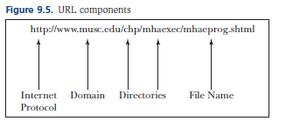
URL Componenets

Slide 36
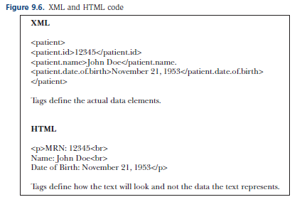
Web Languages
Common Markup Languages
HTML: defines how a page looks on the web by using tags
XML: also defines what the data enclosed in the tags are

Slide 37
Intranet and Extranet
Two types of private Internet-based networks
Intranet: may use both public Internet routes and internal network lines; generally secure
Extranet: similar to Intranet, but are open to select business partners or clients; generally secure

Slide 38
Web Applications
Applications common in Health Care Organizations
Web 2.0
Social networking web sites
Rich Internet applications
Blogs
Podcasts
Wikis
Web Portals
Web Conferencing

Slide 39
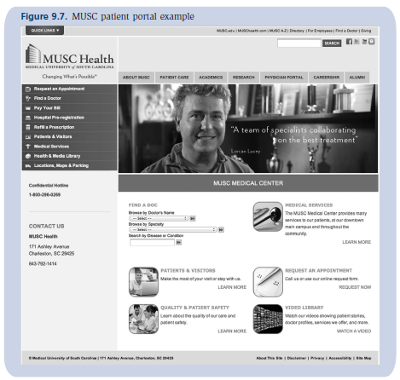
Web Portal Example

Slide 40
E-Commerce Technologies
Basic Components to e-commerce systems
Web server hardware. May be owned and maintained by the health care organization or by a web hosting site
Web server software
E-commerce software. Supports key aspects of e-commerce, including transaction processing and an electronic payment system
High-speed connection to the LAN and Internet

Slide 41
Clinical and Managerial Decision Support
Decision-support systems (DSS)
Artificial intelligence systems, including expert systems, natural language processing, fuzzy logic, and neural networks

Slide 42
Decision Making Process
Intelligence: collecting facts, beliefs, and ideas. In health care these facts may be stored as data elements in a variety of data stores.
Design: designing the methods with which to consider the data collected during intelligence. These methods may be models, formulas, algorithms, or other analytical tools. Methods are selected that will reduce the number of viable alternatives.
Choice: making the most promising choice from the limited set of alternatives.

Slide 43
Decision Support Systems
The stand-alone DSS generally has three distinct components:
The data management module, which is an existing or built-in transactional database or data warehouse. In a clinical DSS, the data module could be a clinical data repository.
The model management module, which allows the user to select a model to be applied to the problem at hand. Models can be mathematical, statistical, or based on expert knowledge. The model management module of a DSS is its most complex component and may seem like a “black box” to the health care executive.
The dialog module, which is the user interface. This module allows the user to pose the problem to the system by selecting the data and the decision model to use on the data. The dialog module also displays results, generally in text and graphical formats.

Slide 44
Artificial Intelligence
Expert Systems: uses heuristics or “rules of thumb” from experts
Natural Language Processing: translates human language to computer instructions
Neural Networks: software programs that involve machine learning

Slide 45
Information System Architecture
The coming together of an information system is guided by the IS architecture
Consists of concepts, strategies, and principles
Platforms are specific vendors and technologies
Infrastructure generally refers to networks and network applications

Slide 46
Architecture Perspectives
Characteristics and Capabilities
Architecture ensures organizationally defined characteristics and capabilities
Application Integration
Best of Breed
Monolithic
Visual integration

Slide 47
Architecture
It is important for health care organizations to have thoughtful architecture discussions

Slide 48
Summary
Information Technology Adoption Challenges
Data Management and Models
Database Models
Database Operations
Databases on the Web
Clinical Data Repositories, data warehouses and data marts
Data mining

Slide 49
Summary
Network and Data Communication
Types of Networks
Network components and performance
Network protocols and standards
Information Distribution Schemes
Remote Access Technologies
Internet and World Wide Web
E-Commerce

Slide 50
Summary
Clinical and Managerial Decision Support
Information System Architecture

