Slide 1
Chapter One
Introduction to Health Care Information

Slide 2
Learning Objectives
To be able to compare and contrast the various definitions of health care information.
To be able to describe the major types of health care information (internal and external) that are captured or used or both in health care organizations.
To be able to cite specific examples of the major types of health care information.
To be able to understand the content and uses of patient records.
To be able to follow a patient’s or client’s health information throughout a typical encounter or process.

Slide 3
Outline
Types of Health Care Information
Internal Data and Information
Patient Encounter Data
Patient Specific Information
Clinical
Administrative
Combined
Aggregate Information
Clinical
Administrative
Combined

Slide 4
Outline (cont.)
Internal Data and Information
Comparative Information
Expert of Knowledge-based Information

Slide 5
Health Care Information Definitions
HIPAA (Adopted by the Joint Commission)
Protected Health Information – Any format created by provider for health care purposes related to an individual
National Health Information Technology
Electronic medical record – electronic used within an organization
Electronic health record – electronic used across organizations
Personal health record – electronic controlled by the individual

Slide 6
Types of Health Care Information Framework
Internal Data/Information
Patient Encounter
Patient specific
Aggregate
Comparative
General Operations
External Data and Information
Comparative
Expert/Knowledge-based

Slide 7
Patient Encounter Data
Primary Purpose Type | Clinical | Administrative
Patient-Specific Those items generally included as a part of the patient medical record are in italics | Identification Sheet Problem List Medication Record History Physical Progress Notes Consultations Physicians’ Orders Imaging and X-ray results Lab results Immunization Record Operative Report Pathology Report Discharge Summary Diagnoses Codes Procedure Codes | Identification Sheet Consents Authorizations Pre-authorization Scheduling Admission/Registration Insurance Eligibility Billing Diagnoses Codes Procedure Codes
Aggregate | Disease Indexes Specialized Registers Outcomes Data Statistical Reports Trend Analysis Ad hoc Reports | Cost Reports Claims Denial Analysis Staffing Analysis Referral Analysis Statistical Reports Trend Analysis Ad hoc Reports

Slide 8
Patient Specific—Clinical
Purpose of Patient Records
Patient care
Communication
Legal documentation
Billing and Reimbursement
Research and Quality Management
Population Health

Slide 9
Patient Specific—Clinical
Content of Patient Records (myPHR, 2012)
Identification Form
Problem List
Medication Record
History and Physical
Progress Notes
Consultation
Physician's Orders

Slide 10
Patient Specific--Clinical
Content of Patient Records (myPHR, 2008)
Imaging and X-ray reports
Laboratory reports
Consent and authorization forms
Operative Reports
Pathology Reports
Discharge Summary
Other

Slide 11
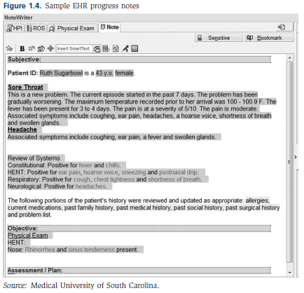
Example Progress Note

Slide 12
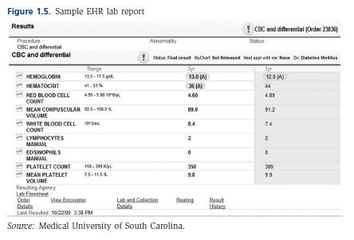
Example Lab Report

Slide 13
Organization of Record Content
Source-Oriented
Chronological by type of content or provider
Problem-Oriented
Organized around patient problems
Special format for notes (SOAP)
Subjective
Objective
Assessment
Plan

Slide 14
Example Problem List

Slide 15
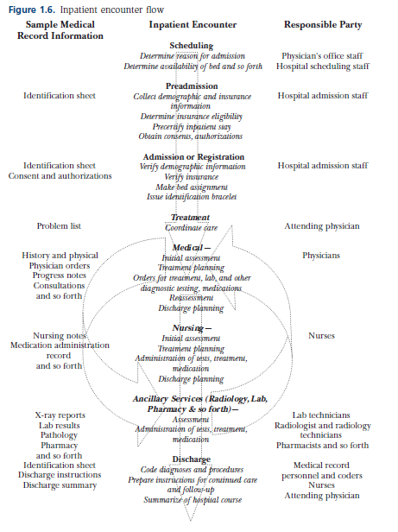
Patient Specific—Clinical
Overview of Inpatient Encounter
Scheduling
Preadmission
Admission/Registration
Treatment
Medical
Nursing
Ancillary
Discharge

Slide 16
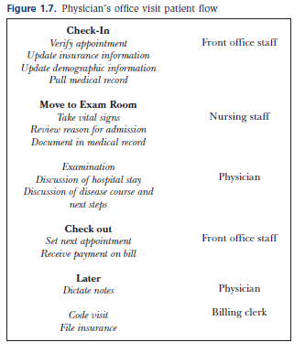
Patient Specific—Clinical
Overview of Physician Office Encounter
Check-in
Move to Exam Room
Examination
Check-out
Later

Slide 17
Patient Specific—Administrative
Data Needed for Reimbursement
UB 04
CMS 1500
Other Uniform Data Sets
UHDDS
ACDS
MDS

Slide 18
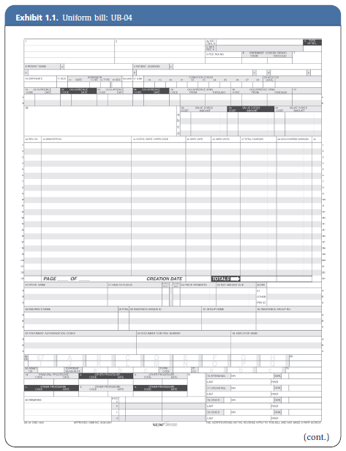
UB-04

Slide 19
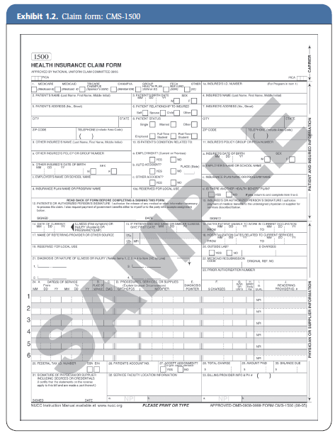
CMS 1500

Slide 20
Uniform Hospital Discharge Data Set Elements Journal of AHIMA 72, no.10 (2001).
UHDDS elements as adopted in 1986 are:
1. Personal identification
2. Sex
3. Race
4. Ethnicity
5. Residence
6. Hospital identification
7-8. Admission and discharge dates
9-10. Attending physician and operating physician
11. Diagnoses: Principal diagnosis & Other diagnoses
12. Procedure and date
13. Disposition of patient
14. Expected payer

Slide 21
Patient Specific—Combined
Coding Systems
ICD-9-CM ( Replaced by ICD-10-CM & PCS in 2014)
National Center for Health Statistics
Inpatient and Outpatient Diagnoses
Inpatient Procedures
CPT
American Medical Association
Outpatient Procedures

Slide 22
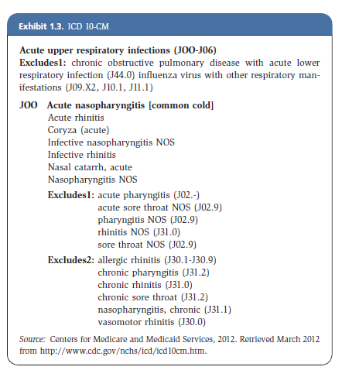
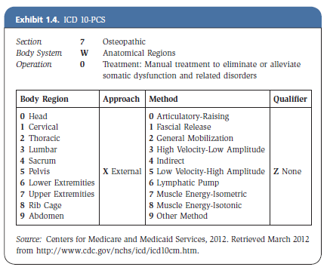
ICD 10-CM & PCS

Slide 23
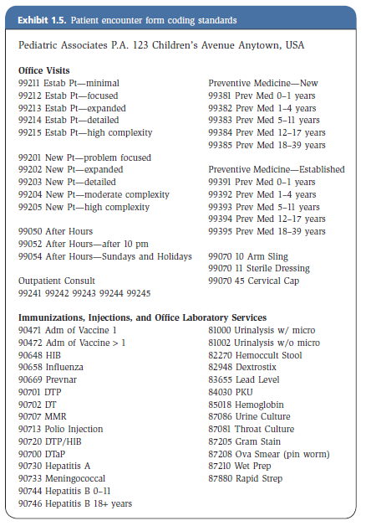
CPT

Slide 24
Patient Specific—Combined
Coding Standards
Compliance Issues
Fraud & Abuse Issues

Slide 25
Aggregate—Clinical
Disease and Procedure Indexes
Specialized Registers
Emergency Room
Operating Room
Trauma
Tumor
Other
Ad hoc Reports

Slide 26
Sample Diabetes Query

Slide 27
Aggregate—Administrative
Limitless Ad hoc Reports
Specific Examples
Medicare Cost Reports
Health Care Statistics
Census
Discharge

Slide 28
Aggregate—Combined
Ad hoc Reports
Trend analysis
Statistical reports
Quality improvement

Slide 29
Comparative Data Uses
Benchmarking
Outcome Measures
Balanced Scorecards
Clinical Value Compass

Slide 30
Comparative Data Sources
Patient Satisfaction
CMS: Hospital Consumer Assessment of Healthcare Providers and Systems (HCAHPS)
Private Organizations: Press Ganey, Gallup, etc.
Practice Patterns
Commonwealth Fund Chartbook
Dartmouth Atlas

Slide 31
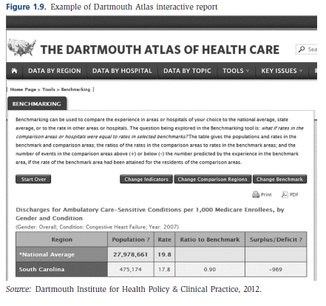
Example Dartmouth Atlas
http://www.dartmouthatlas.org

Slide 32
Comparative Data Sources
Health Plans
NCQA HEDIS measures
NCQA Report Cards
Clinical Indicators
The Joint Commission Quality Check
CMS Hospital Compare
Population Measures
CDC
AHRQ

Slide 33
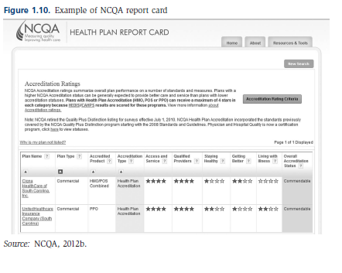
Example NCQA Report Card
http://reportcard.ncqa.org/plan/external/plansearch.aspx

Slide 34
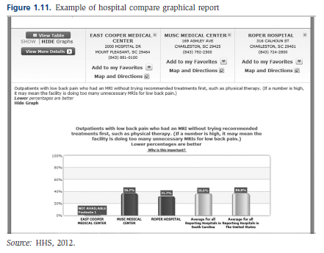
Example CMS Hospital Compare
www.hospitalcompare.hhs.gov

Slide 35
Expert of Knowledge-based
Clinical, scientific and management print literature
On-line resources

Slide 36
Summary
Types of Health Care Information
Internal
Patient Specific Information
Clinical
Administrative
Combined
Aggregate Information
Clinical
Administrative
Combined

Slide 37
Summary (cont.)
External
Comparative Information
Expert of Knowledge-based Information

