Slide 1
Chapter Three
Health Care Information Regulations, Laws and Standards

Slide 2
Learning Objectives
Discuss how accreditation, facility licensure, and certification influence the information needs of health care facilities.
Identify and differentiate among major health care accrediting bodies.
Understand and manage the impact of the health record as a legal document.
Discuss the HIPAA privacy regulations and their relevance to health care organizations and consumers.
Describe the laws, regulations, and standards that govern patient confidentiality.

Slide 3
Outline
Licensure, Certification & Accreditation
Facility Licensure
Certification
Joint Commission Accreditation
Other Accrediting Organizations

Slide 4
Outline
Legal Aspects of Health Care Information
Health Record as a Legal Document
Definition
Retention of Health Records
Authentication
Privacy and Confidentiality
Pre-HIPAA
HIPAA
Release of Information

Slide 5
Facility Licensure
States oversee facility licensure
Facilities must have a license to operate
Emphasis is on standards for physical plant, safety, etc.
Minimum standards for patient records

Slide 6
Certification
Gives authority to participate in Medicare and Medicaid
Standards were established in 1970’s
Hospitals with Joint Commission Accreditation have “deemed” status

Slide 7
Accreditation
Voluntary external review
Well known agencies
Joint Commission—hospitals and other health care facilities
NCQA—managed care plans
CARF—Rehabilitation facilities
AAAHC—Ambulatory care facilities

Slide 8
Accreditation
Possible Benefits
Deemed status for CMS programs and some state licensure
Required for reimbursement from some payers
Validates quality of care
May influence liability insurance
May enhance managed care contracts
Gives competitive edge over non-accredited

Slide 9
Joint Commission (www.jointcommission.org)
Founded as non-profit in 1951 for hospitals
Now includes other types of healthcare organizations
82% of US hospitals; ~19,000 health care organizations
Survey every three years to compare practice to standards

Slide 10
Joint Jommission (www.jointcommission.org)
Accreditation decisions
Preliminary accreditation
Accredited
Accreditation with follow-up survey
Contingent accreditation
Preliminary denial of accreditation
Denial of accreditation

Slide 11
Joint Commission (www.jointcommission.org)
Emphasis on health care information and documentation of care
~150 JCAHO hospital standards are scored on patient medical record alone
In 2009 established two chapters from previous Information Management chapter
Record of Care, Treatment and Services (RC)
Information Management

Slide 12
Joint Commission RC Standards
Maintain complete and accurate medical records for each patient
Ensure entries are authenticated appropriately
Ensure documentation is timely
Audit medical records
Retain medical records according to law
Ensure medical records contain information that “reflects the patient’s care, treatment and services”
Ensure medical records reflect operative and high risk procedures; sedation and anesthesia
Ensure documentation of use of restraints and seclusion
Ensure ambulatory records contain a summary list
Ensure qualified staff receive and record verbal orders
Document specific discharge information for each patient

Slide 13
Joint Commission RC Standards
RC Standards apply whether the organization uses electronic, paper or combination health records

Slide 14
Joint Commission Information Management
Information is a resource that must be managed like any other resource within the health care organization
IM standards relate to
IM planning
IM processes
Privacy, security, and integrity
Data collection, retrieval, dissemination, and transmission
Information-based decision making
Accuracy

Slide 15
NCQA (www.ncqa.org)
National Committee for Quality Assurance
Accreditation of health plans and managed care organizations
HEDIS and measuring quality (chapter 1)

Slide 16
NCQA (www.ncqa.org)
Began accrediting MCOs in 1991
Voluntary process
Accreditation requirements are published at www.ncqa.org
Accreditation surveys by teams of health care providers
Surveys rely heavily on data including HEDIS measures

Slide 17
NCQA (www.ncqa.org)
Assigns one of five accreditation levels
Excellent
Commendable
Accredited
Provisional
Denied

Slide 18
Other Accrediting Bodies
Commission of Accreditation of Rehabilitation Facilities (CARF)
www.carf.org
Accreditation Association for Ambulatory Health Care (AAAHC)
www.aaahc.org

Slide 19
Patient Safety Organizations
Established by Patient Safety and Quality Improvement Act of 2005 (Patient Safety Act) and implemented in 2009
Responsible for collection and analysis of voluntarily submitted health information
Tracks patient safety trends and provides feedback to providers

Slide 20
Health Record as a Legal Document
What is the Legal Health Record?
No simple answer in the electronic environment
State and Federal laws are being modified
Organizations have an obligation to clearly define the components of the LHR

Slide 21
Health Record as a Legal Document
AHIMA recommends organizations completed a “health record matrix” outlining:
Type and name of components
Primary source
System start date
Location for legal purposes
Whether or not it is part of the LHR

Slide 22
Health Record as a Legal Document
LHR generally…
Will include all components of the clinical record
Will include patient identifiable source clinical data, e.g. X-rays, fetal strips, images
May include records from other providers may or may not be included
Will not include administrative records, e.g. committee, encounter forms

Slide 23
Retention of Health Records
Most states have retention requirements
When no state requirements retain records
At least as long as the statute of limitations or other regulations
For minors, until the age of majority (defined by the state)
AHIMA (2011) recommends 10 years for adults; age of majority plus statute of limitations for children

Slide 24
Destruction of Health Records
Some states have guidelines or requirements for destroying LHRs
AHIMA (2011) has developed guidelines
Destroy records so there is no possibility of reconstruction, e.g. burn, shred or pulverize paper; degauss computerize data
Document the destruction completely

Slide 25
Authentication of Health Information
State and federal laws and accreditation standards require that health record entries be authenticated
Authentication generally may be by handwritten or electronic signature

Slide 26
Privacy and Confidentiality
Privacy—individual's right to be left alone
In health care—the right to limit access to health care information
Confidentiality—the expectation that information will only be used for its intended purpose
Confidentiality relies on trust

Slide 27
Privacy and Confidentiality
Pre-HIPAA
A few federal and state laws, but no comprehensive federal regulation to protect private health information
HIPAA
Multiple Sections, including
Privacy Rule

Slide 28
HIPAA Privacy Rule
Key definitions
Covered Entities
Health plans
Health care clearinghouses
Health care providers

Slide 29
HIPAA Privacy Rule
Key definitions
Protected Health Information (PHI)
Relates to physical or mental health, provision of or payment for health care
Identifies the person
Created or received by a covered entity
Transmitted or maintained in any form

Slide 30
HIPAA Privacy Rule
Five major components
Boundaries
Security
Consumer control
Accountability
Public Responsibility

Slide 31
HITECH Expansion of HIPAA Privacy Rule
HITEC expansion of Privacy & Security Rules
Applies requirements directly to business associates
Established mandatory breach reporting
Established new criminal and civil penalties
Strengthened privacy requirments

Slide 32
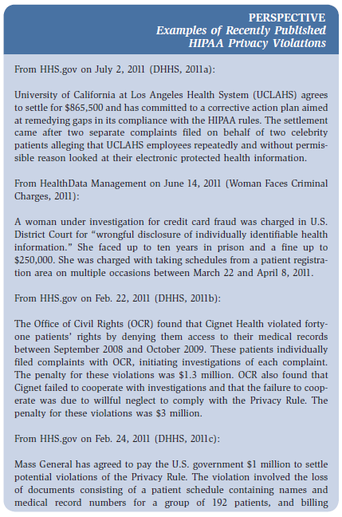
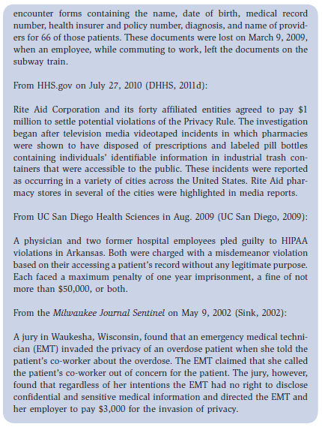
Recent Published Privacy Violations

Slide 33
Release of Information
Health care organizations need comprehensive policies and procedures for releasing patient information
Routine Use –requires consent
Non-routine Use—requires authorization

Slide 34
Release of Information Authorization Elements
Patient Name
Patient Date or Birth
Name of entity to whom the information is being released
Description of the health information being disclosed
Statement of the reason or purpose for the disclosure
Date, event or condition on which the authorization will expire
Statement that the authorization may be revoked by the patient (or legal representative)
Patient (or legal representative) signature
Date of signature—must be after the encounter

Slide 35
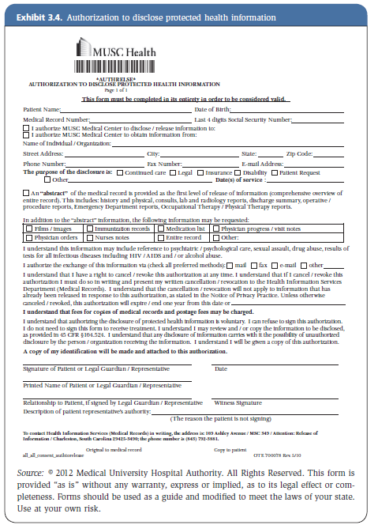
Authorization for Release of Information– Authorization to Disclose PHI

Slide 36
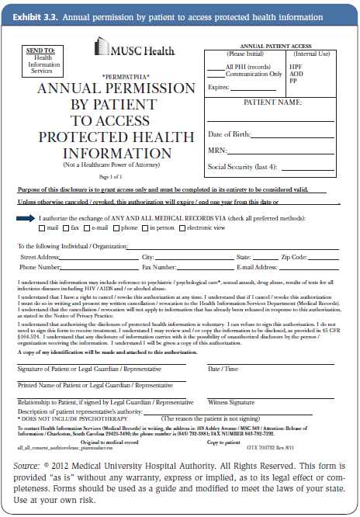
Authorization for Release of Information– Annual Permission to Access PHI

Slide 37
Summary
Facility Licensure
Certification
Accreditation Standards and Processes
Joint Commission (www.jcaho.org)
NCQA (www.ncqa.org)
Other Accrediting Bodies

Slide 38
Summary (cont.)
Health Record as a Legal Document
Retention of Health Records
Authentication of Health Information
Privacy and Confidentiality
HIPAA Privacy Rule
Release of Information

