Slide 1
Chapter 5
Clinical Information Systems

Slide 2
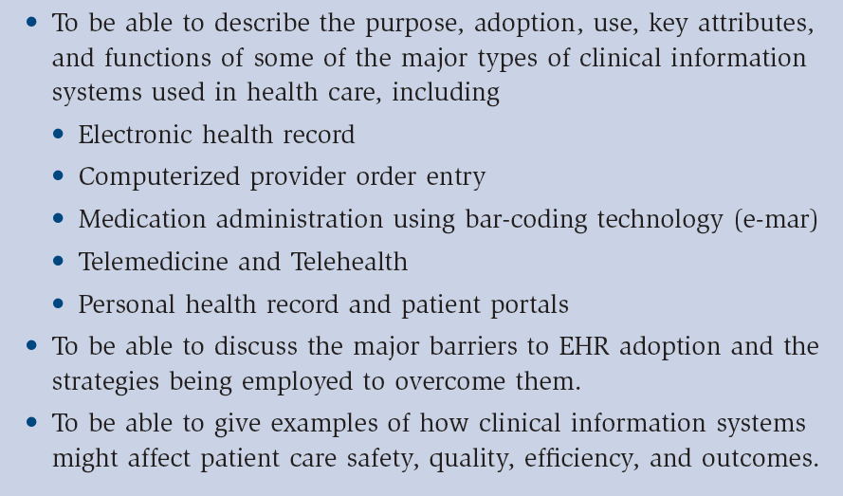
Learning Objectives

Slide 3
Outline
Clinical Information Systems—adoption, use, value
Electronic Health Record
Computerized Provider Order Entry (CPOE)
Medication Administration
Telemedicine/Telehealth
Personal Health Record
Fitting Applications Together
Information Exchange Across Boundaries
Overcoming Barriers to Adoption

Slide 4
Various terms used over time
CPR
Computer-Based Patient Record
EMR
Electronic Medical Record
PHR
Personal Health Record
EHR
Electronic Health Record

Slide 5
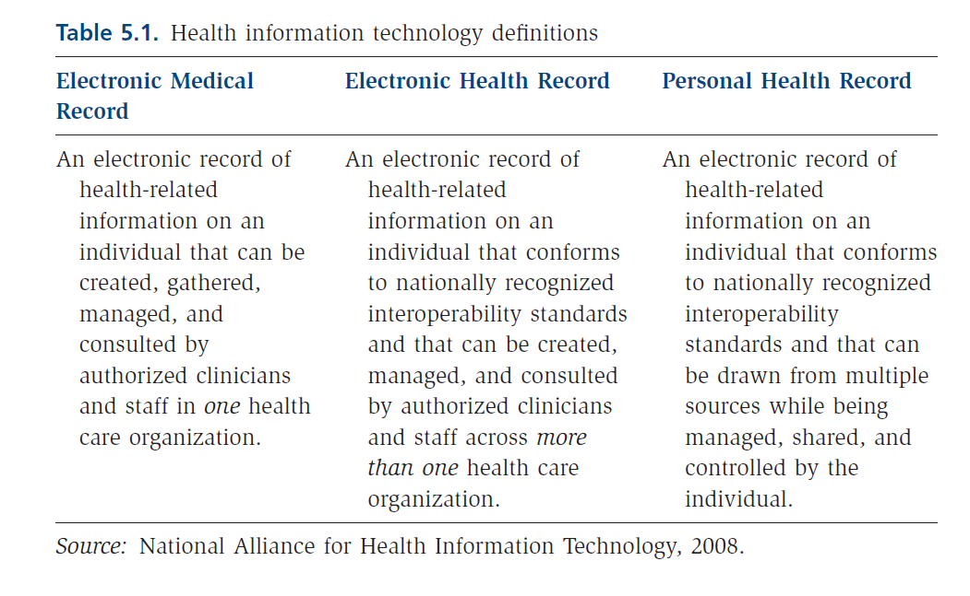
Definitions

Slide 6
Core Functions

Slide 7
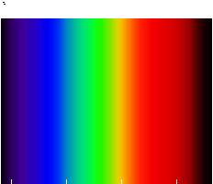
Where are we today?
Broad Spectrum

Slide 8
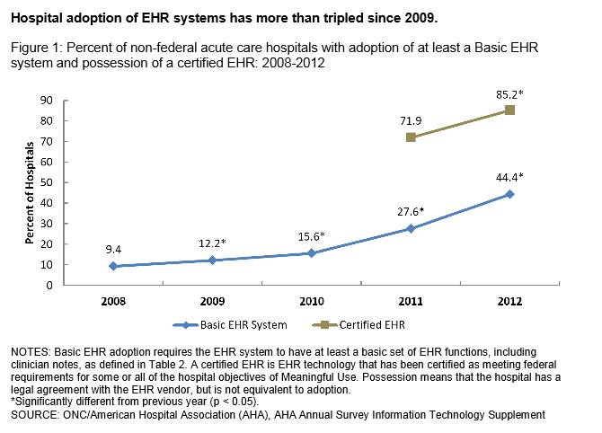
EHR Adoption in US Hospitals

Slide 9
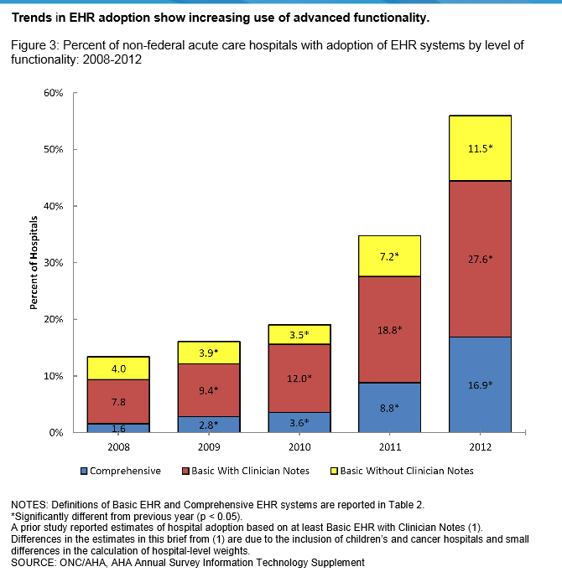

Slide 10
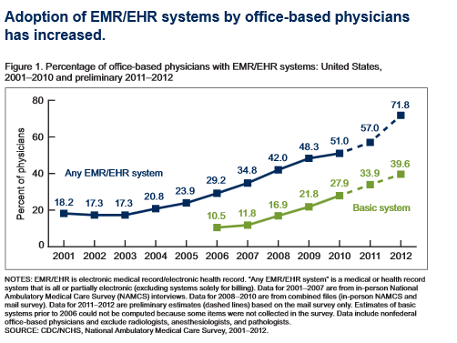
2012 Physician Adoption of EHRs

Slide 11
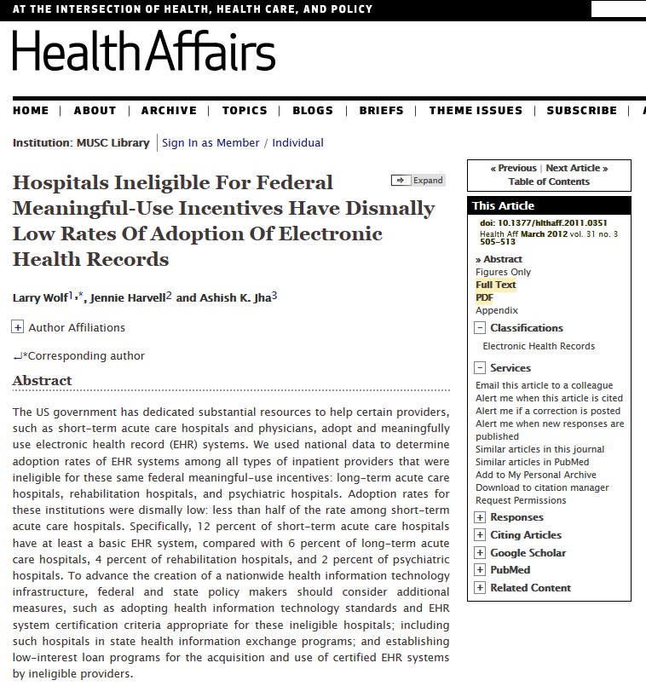
EHR Use in Other Post Acute and LTC Settings
Extremely low
6%--Long term care
4%--Rehabilitation
2%--Psychiatric
Source: Health Affairs, 2012

Slide 12
Value of EHR
Improved quality, outcomes and safety
Computerized reminders and alerts
Improved compliance with practice guidelines
Reduction in medical errors
Improved efficiency, productivity, and cost reduction
Improved service and satisfaction

Slide 13
Other major types of CIS
Computerized provider order entry (CPOE)
Medication administration using barcoding
Telemedicine
Telehealth—for our purposes, we will focus on online communication (e.g. email) between patients and providers
Personal health record

Slide 14
CPOE
Driven by need to improve patient safety
Automates the ordering process
Accepts orders electronically, provides decision support, may aid in diagnosis and treatment

Slide 15
Use and Status of CPOE
Estimates vary from 8-20%
Historically teaching hospitals more likely to use
Many organizations are in various stages of implementation
Required for achieving meaningful use

Slide 16
Historical Barriers to CPOE Use
Complexity of ordering process
Physician entry an issue
Takes longer to place order; many systems are ‘cumbersome’, take too many steps
Incentives may not be aligned with use
Lack of confidence in system reliability
Insufficient training
Mandating use – should you?

Slide 17
Medication administration
Use of barcoding becoming more widespread
Aids in correctly identifying patient, drug, dose, etc.
HIMSS implementation guide—good resource
More widely accepted
Has been used successfully by many health care organizations
Again, has potential to aid in making sure the right meds, get to the right patient, at the right dose…

Slide 18
Telemedicine
Use of telecommunciations for the direct provision of care to patients at a distance
Over 200 telemedicine programs involving over 3500 health care institutions
Store and forward
Two-way interactive TV
Funding an issue
Cost effectiveness not fully known

Slide 19
Telehealth
Using telecommunications to communicate with patients and deliver services
Electronic consultations (e-consultations)
Patient portals
Refilling prescriptions
Registering patient
Scheduling appointments

Slide 20
Telehealth
Current use of email communication between patients and physicians
Value to patients and providers
Issues
Complexity of infrastructure
Degree of integration
Message structure
Cost
Security
Reimbursement

Slide 21
Personal Health Record & Patient Portals
Managed by consumer
May include both health and wellness information
Patient portal—secure web site through which patients can access PHR or EHR
Approximately 7% of consumers have PHR

Slide 22
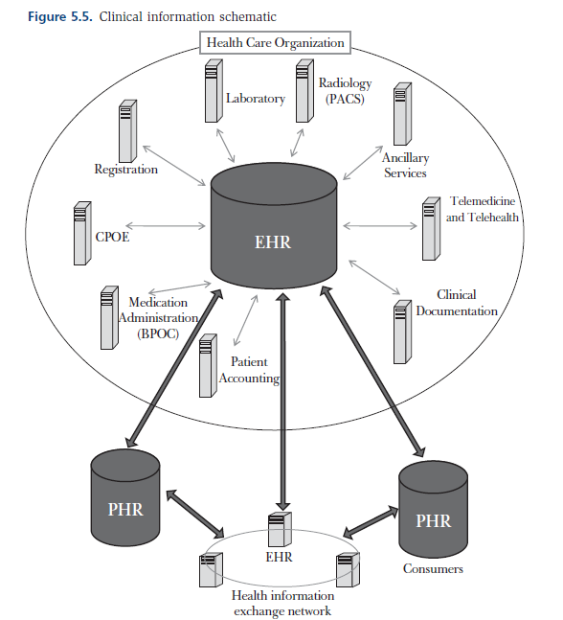
Fitting Pieces Together

Slide 23
Barriers to Adoption & Strategies for Overcoming Them
Financial
Organizational or Behavioral
Technical Barriers
Privacy and Security Barriers

Slide 24
Strategies for Overcoming Barriers
What strategies are being employed to help overcome—
Financial barriers?
Behavioral barriers?
Technical barriers?

Slide 25
Summary
Examined five clinical information systems—their current use, status, and value & their relationship to each other
Discussed the value of sharing health information across organizations
Discussed the three major barriers to adoption of these systems—financial, behavioral and technical and strategies to overcome them

