Slide 1
Chapter 6
Federal Efforts to Enhance Quality of Patient Care Through Use of Health IT

Slide 2
Learning Objectives
To gain understanding of major federal legislation passed in recent uses to promote adoption and meaningful use of EHR systems
To describe Medicare and Medicaid EHR incentive programs
To discuss implications of health care reform and new models of care on health information management needs

Slide 3
Learning Objectives
To define health information exchange (HIE) and discuss efforts underway nationally to promote exchange of health data across organizations.
To discuss the health IT ramifications of payment reform

Slide 4
Outline
HITECH Act
Components of Act
Medicare and Medicaid EHR Incentive Programs
Meaningful Use: Definition and criteria
Role of the ONC and CMS
Health Care Reform: New modes of care and payment reform
Health Information Exchange (HIE)
IT Ramifications of New Models of Care and Payment Reform

Slide 5
HITECH Act
Health Information Technology Economic and Clinical Health Act (HITECH)
Established Medicare and Medicaid EHR Incentive Programs
Established 62 Regional Extension Centers
Created health IT workforce educational opportunities
Identified Beacon communities and Strategic Health IT Advanced Research Projects (SHARPs)
HIE infrastructure—Nationwide Health Information Network (NwHIN)
EHR certification
Expanded Privacy and Security Regulations

Slide 6
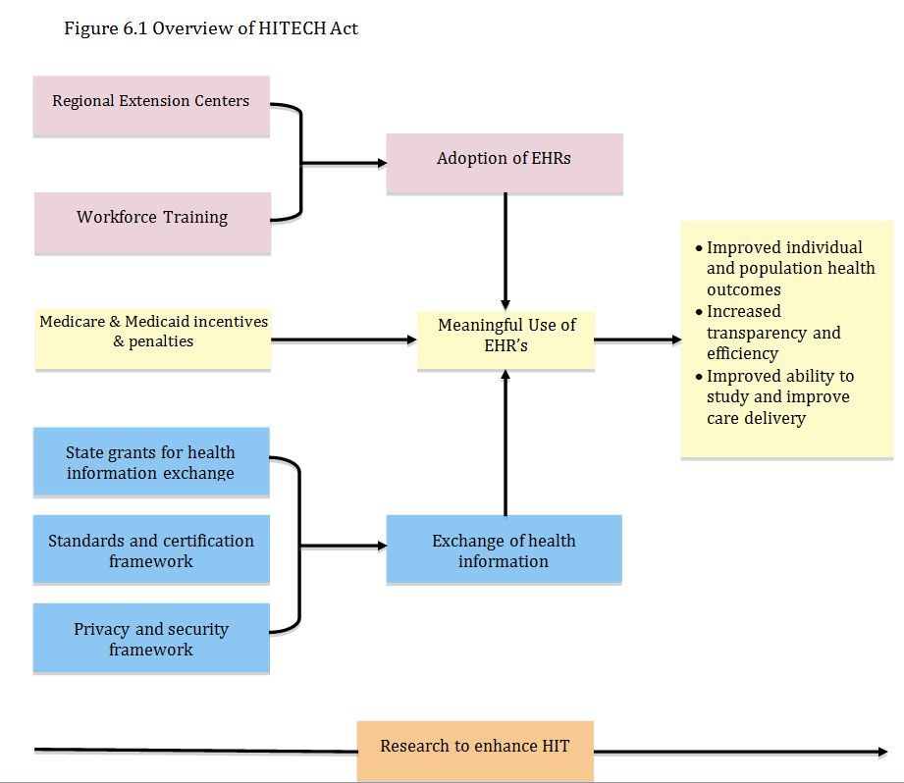

Slide 7
Goals of HITECH Act
Improve individual and population health outcomes
Increase transparency and efficiency
Improve ability to study and improve care delivery

Slide 8
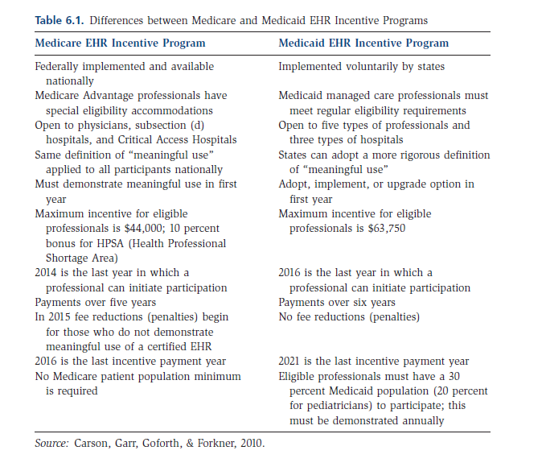
EHR Incentive Programs

Slide 9
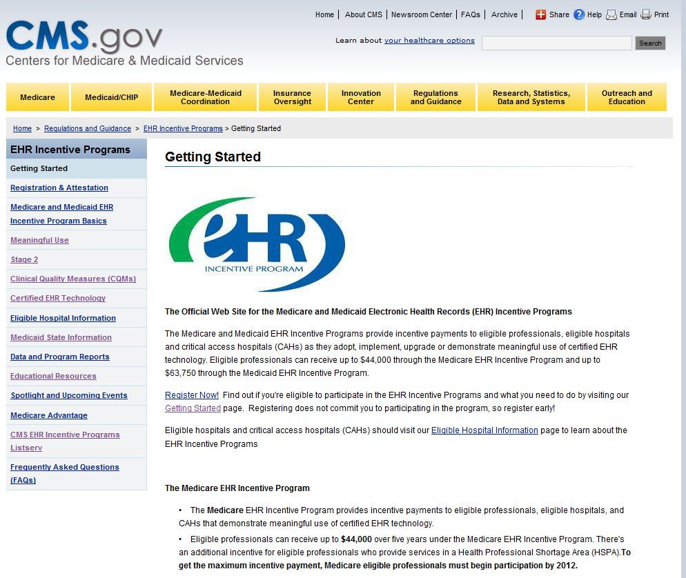
Overview of EHR Incentive program and meaningful use
CMS offers two EHR incentive programs
Medicare
Hospitals (including CAH)
Eligible practitioners
Medicaid
Hospitals (including CAH and Children’s Hospitals
Eligible practitioners
CMS EHR Incentive Program

Slide 10
To be eligible
Must use a certified EHR in a meaningful way
Use an EHR that can exchange information electronically with other systems
Submit reports to CMS that include performance measures proving that you mean meaningful use criteria

Slide 11
EHR Certification and meaningful use
Office of the National Coordinator for Health IT (ONC) defines certification criteria for EHR (how EHR must work)
CMS defines meaningful use (how EHR must be used)

Slide 12
Meaningful use linked with nation’s health outcome policy priorities
Improve health care quality, safety, efficiency and reduce health care disparities
Engage patients and families in their health care
Improve care coordination
Improve populations and public health
Ensure adequate privacy and security of PHI

Slide 13
Meaningful use

Slide 14
Funding not enough…
Also need expertise
..Regional extension centers
..Health IT workforce training programs
..ability to learn from others (e.g. Beacon communities)
Facilitate exchange of health information
Standards and certification
Privacy and security

Slide 15
Regional Extension Centers (RECs)
Provide advice and technical assistance to primary care providers (especially those in small practices)
Assist small rural hospitals without IT expertise
Assist in selection and implementation of EHR

Slide 16
ONC and CMS Roles
Office of the National Coordinator for HIT (ONC)
Develops policies that implement the overall HITECH Act
Specifies standards, implementation specifications and EHR certification
CMS
Promulgates policy related to Medicare and Medicaid EHR Incentive payment for meaningful use

Slide 17
Federal Health IT Strategic Map

Slide 18
Health Care Reform: New Modes of Care and Payment Reform
Patient Protection and Affordability Care Act (2010)—a few provisions
Mandates health insurance
Expands Medicaid to those up to 133% of federal poverty level
Introduces health insurance exchange—greater role for states
Prohibits placement of lifetime limits and coverage for pre-existing conditions
CMS establishes Innovation Center to study different payment models

Slide 19
Two proposed frameworks
Accountable Care Organizations (ACOs)—
network of physicians and other providers who work together to improve quality of care services and reduce costs for a define population (Merlis, 2010).
Patient Center Medical Home (PCMH)
Provide comprehensive primary care throughout individual’s life by facilitating partnerships between the patient, his or her providers, and if appropriate, the patient’s family.

Slide 20
ACOs and PCMHs require health IT
Manage and coordinate integrated care
Identify, manage and contain costs
Adhere to evidence-based practice guidelines
Manage populations health
Report on quality outcomes

Slide 21
New Forms of Payment
Bundled payments
Pay for performance
Shared savings programs
Capitation or global payment
Episode of care
Other variations

Slide 22
Health Information Exchange
Essential to new models of care and payment reform
HIE
Electronic movement of health related information among organizations according to nationally recognized standards (verb)
A health information organization that brings together stakeholders within a defined geographical area and governs HIE among them for the purpose of improving health and care in the community (noun)

Slide 23
HIE Benefits
Promotes improved patient care, quality and safety
Makes relevant health information readily available
Provides means to reduce duplication of services
Provides governance and management over data exchange process
Facilitates achievement of meaningful use requirements

Slide 24
Nationwide Health Information Network (NwHIN)
set of standards, services, and policies that enable the secure exchange of health information over the Internet
intent is to securely link regional and state HIEs
Direct Project
CONNECT Open Source Solution

Slide 25
HIE Lessons
Align stakeholders with HIE priorities
Establish and maintain consistent brand identify and role as trusted, neutral entity
Ensure along with vision in making strategic choices
Consider structural characteristics and dynamics
Understand clinical workflow and change management
(NeHC, Secrets of HIE Success Revealed, 2011)

Slide 26
IT Ramifications of Reform
Ability to accurately identify and link patient data
Share patient information in standardized format
Establish care coordination systems
Explore patient engagement systems
Participate in disease registries
Monitor performance and report quality

Slide 27
Summary
Federal legislation in health care reform has had significant impact on adoption and use of EHR
Increased emphasis on new models of care and payment reform
Health information exchange critical component
Individual health care organizations and providers will need to ensure they have IT capabilities to effectively mange care resources under new models of care and payment reform

