Slide 1
Chapter 7
System Acquisition

Slide 2
Learning Objectives
Explain the process a HCO generally goes through in selecting a HCIS.
Describe the SDLC and its four major stages.
Discuss the various stages for acquiring a HCIS and pros and cons of each.
Discuss the purpose and content of a RFI and RFP in the system acquisition process.
Gain insight into the problems that may occur during system acquisition.
Gain an understanding of the health care IT industry.

Slide 3
Outline
Definition of System Acquisition
Systems Development Life Cycle
The System Acquisition Process
Project Management Tools
Things That Can Go Wrong

Slide 4
System Acquisition
The process that occurs from the time the decision is made to select a new system (or replace an existing system) until the time a contract has been negotiated and signed.

Slide 5
Systems Development Life Cycle
Blueprint to aid in the planning, selection, implementation, and support of a health care information system.
Phases—
Planning and Analysis
Design
Implementation
Support and Evaluation
System Acquisition

Slide 6
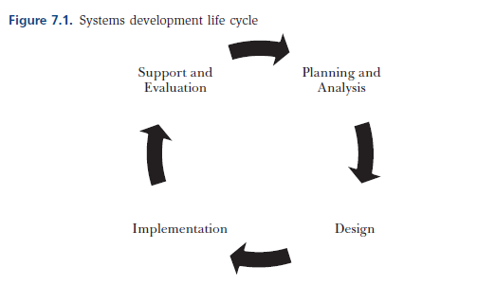
SDLC

Slide 7
Prior to System Acquisition
Health care executive team should
Engage in strategic information systems planning
Identify goals and strategies and how IT will be employed to aid the organization in achieving them
Establish IT priorities
Gain budgetary approval and institutional support

Slide 8
The System Acquisition Process
Establish project steering committee and appoint project manager
Size and composition
Knowledge and skills
Define project objectives and scope of analysis
Decide what you hope to achieve as a steering committee

Slide 9
The System Acquisition Process
Determine system goals
What does the organization hope to accomplish by implementing the proposed system? What is it looking for in a system?
Goals should be specific and measurable and congruent with the strategic goals of the organization
Determine and prioritize system requirements

Slide 10
The System Acquisition Process
Develop and distribute the request for proposal or request for information
What is generally included in an RFP?
How does an RFI differ from an RFP?

Slide 11
Typical Components of an RFP
Instructions for vendors
Organization objectives
Background of the organization
System goals and requirements
Vendor qualifications
Proposed solutions
Criteria for evaluating proposals
General contractual requirements
Pricing and support

Slide 12
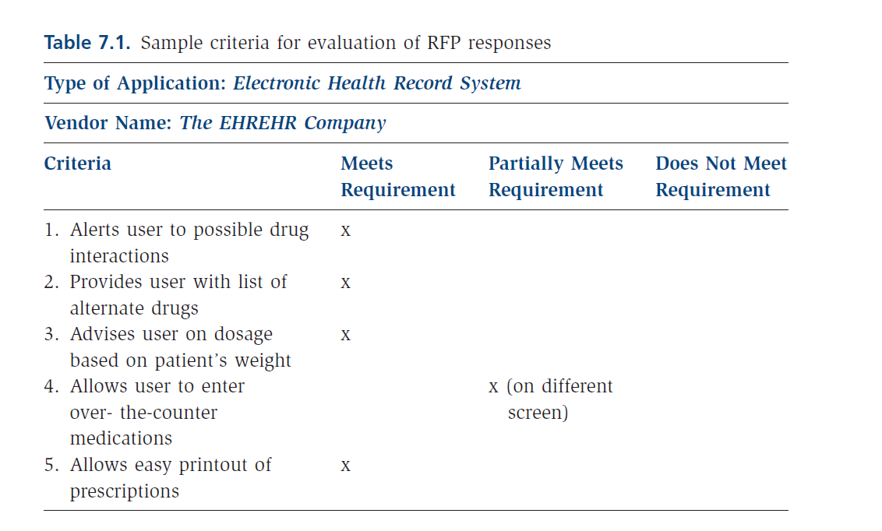
Evaluate RFP

Slide 13
The System Acquisition Process
Conduct a cost-benefit analysis
Identify acquisition and support costs
Identify and evaluate potential benefits of each option
Prepare a summary report and recommendations
Recommend having at least 2-3 vendors in final ranking
Conduct contract negotiations

Slide 14
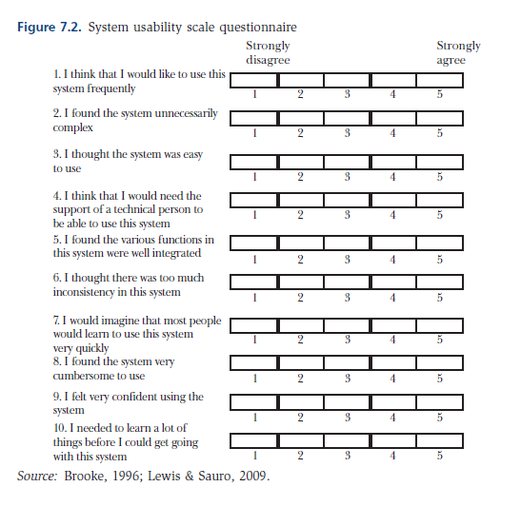
Assess Usability

Slide 15
Despite the best made plans, things can and do go wrong…
Failure to manage vendor access to organization leadership
Failure to keep the process objectives (getting caught up in the vendor razzle-dazzle)
Overdoing or under-doing the RFP
Failure to involve the leadership team and users extensively during the system selection
Turning negotiations into a blood sport

Slide 16
Summary
Important to effectively manage system acquisition process
Key tasks that generally occur
Importance and composition of project repository
Things that can derail the acquisition process

