Slide 1
Chapter Ten
Health Care Information System Standards

Slide 2
Learning Objectives
Give examples of the four major methods by which standards are developed—ad hoc, de facto, government mandate, and consensus.
Identify the major types of health care information standards and the organizations that develop or approve them, including
Classification standards
Standards for electronic data interchange
Vocabulary and terminology standards
Health record content and functional standards
Identify and discuss the role of organizations that currently have a significant impact on the adoption of health care information standards in the United States.
Identify and discuss the role of federal initiatives and legislation that have a significant impact on the adoption of health care information standards in the United States.
Discuss the Nationwide Health Information Network.

Slide 3
Outline
Standards Development Process
Standards that support Health Care Information System Interoperability
Classification Standards
Vocabulary and Terminology Standards
Health Record Content and Functional Standards
Federal Initiatives Affecting Health Care IT Standards

Slide 4
Standards Development Process
Four Methods (Hammond & Cimino, 2001)
Ad hoc—no formal adoption process
De facto—vendor or other has a very large segment of the market
Government mandate
Consensus—volunteers from organizations come together to reach a formal agreement

Slide 5
Formal Standards Development
Organizations
International Organization for Standardization (ISO) www.iso.org
American National Standards Institute (ANSI) www.ansi.org
Standards Development Organizations (SDOs)
ASTM International www.astm.org
Health Level 7 www.hl7.org
ANSI ASC X12 www.x12.org

Slide 6
ISO
Facts
Members are national standards bodies from many countries
ANSI is the US national body member
Oversees the flow of documentation and international approval of standards developed by its member bodies

Slide 7
ANSI
Facts
US member of ISO
Accredits SDOs from a wide range of industries (including health care)
Oversees work of SDOs
Does NOT develop standards
Publishes the 10,000+ standards developed by SDOs

Slide 8
SDOs
Facts
Must be accredited by ANSI
Develops standards in accordance with ANSI criteria
Can use the label “Approved American National Standard”
270+ ANSI-accredited SDOs representing many industries, including health care

Slide 9
Classification Standards
HCPCS (ancillary services or procedures) (discussed in Chapter One)
CPT-4 (physicians procedures) (discussed in Chapter One)
ICD-9 (ICD-10 as of October 2014 for diagnoses and hospital inpatient procedures) (discussed in Chapter One)
CDT (dental terminology)
NDC (national drug codes)
(CMS, 2012a)

Slide 10
CDT
Code on Dental Procedures and Nomenclature
I. Diagnostic (D0000–D0999)
II. Preventative (D1000–D1999)
III. Restorative (D2000–D2999)
IV. Endodontics (D3000–D3999)
V. Periodontics (D4000–D4999)
VI. Prosthodontics (D5000–D5899)
VII. Maxillofacial prosthetics (D5900–D5999)
VIII. Implant services (D6000–D6199)
IX. Prosthodontics [AU: This change correct?yes](D6200–D6999)
X. Oral and maxillofacial surgery (D7000–7999)
XI. Orthodontics (D8000–8999)
XII. Adjunctive General Services (D9000-D9999)

Slide 11
NDC
National Drug Code Tylenol PM (Extra Strength) is as follows:
Product NDC: 50580-176
Product Type Name: Human OTC Drug
Proprietary Name: Tylenol PM (Extra Strength)
Non-proprietary Name: Acetaminophen and Diphenhydramine Hydrochloride
Dosage Formulation: Tablet, Coated
Route Name: Oral
Start Marketing Date: 12-01-1991
End Marketing Date: <blank field>
Marketing Category Name: OTC Monograph Final
Application Number: part338
Labeler Name: McNeil Consumer Healthcare Div. McNeil-PPC, Inc
Substance Name: Acetaminophen; Diphenhydramine Hydrochloride
Strength Number/Unit: 500 mg/1, 25 mg/1
Pharm Class: Histamine H1 Receptor Antagonists [MoA], Histamine-1 Receptor Antagonist [EPC]
Package Code: 50580-176-10
Package Description: 1 Bottle, Plastic in 1 Carton (50580-176-10) > 100 tablet, coated in 1 Bottle, Plastic
DEA classification: <blank>

Slide 12
Vocabulary and Terminology Standards
National Committee on Vital and Health Statistics (NCVHS) recommends:
Systematized Nomenclature of Medicine—Clinical Terms (SNOMED CT)
Logical Observation Identifiers Names and Codes (LOINC) laboratory subset
Several federal drug terminologies, including RxNorm

Slide 13
Vocabulary and Terminology Standards
HITECH “meaningful use” final rule (discussed in Chapter Four) also includes vocabulary standards, SNOMED CT, LOINC, CVX and RxNorm
National Library of Medicine Unified Medical Language

Slide 14
SNOMED CT
Systematized Nomenclature of Medicine—Clinical Terms
comprehensive clinical terminology developed specifically to facilitate the electronic storage and retrieval of detailed clinical information
collaboration between the College of American Pathologists (CAP) and the United Kingdom’s National Health Service (NHS)
owned, maintained, and distributed by the International Health Terminology Standards Development Organisation (IHTSDO), a nonprofit association
National Library of Medicine distributes at no cost within the United States

Slide 15
LOINC
Logical Observation Identifiers Names and Codes
developed to facilitate the electronic transmission of laboratory results to hospitals, physicians, third-party payers, and other users of laboratory data
LOINC Code: Component: Property Measured: Timing: System: Scale: Method
Example
5193-8:Hepatitis B virus surface Ab: ACnc:Pt:Ser:Qn:EIA

Slide 16
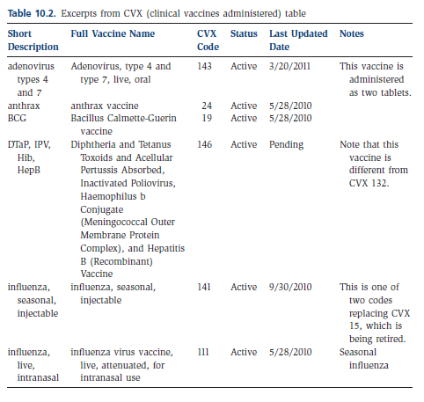
CVX
Clinical Vaccines Administered
CDC National Center of Immunization and Respiratory Diseases (NCIRD) developed the CVX as a table for use with HL7 messaging standard

Slide 17
RxNorm
National Library of Medicine (NLM) produces RxNorm
The goal of RxNorm is to allow disparate health information systems to communicate with one another in an unambiguous manner
There are twelve separate RxNorm data files that are released on a monthly basis. The files include
Drug names and unique identifiers
Relationships
Attributes
Semantic types
Data history (three files)
Obsolete data (three files)
Metadata (two files)

Slide 18
UMLS
Unified Medical Language System
National Library of Medicine project
Purpose is to facilitate the development of computer systems that behave as if they ‘understand’ the meaning of the language of biomedicine and health

Slide 19
UMLS
Three Knowledge Sources
UMLS Metathesaurus®: contains over one million biomedical concepts from over one hundred source vocabularies, including SNOMED CT, ICD, CPT, & RxNorm. The project’s goal is to incorporate and map existing vocabularies into a single system.
UMLS Semantic Network: defines 133 broad categories and fifty-four relationships between categories for labeling the biomedical domain. The semantic network contains information about the categories (such as “Disease or Syndrome” and “Virus”) to which metathesaurus concepts are assigned. The semantic network also outlines the relationships among the categories (for example, “Virus” causes “Disease or Syndrome”).
SPECIALIST Lexicon and Lexical Tools. The lexicon contains information for many terms, component words, and English language words that do not appear in the metathesaurus.

Slide 20
Data Interchange Standards
Health Level Seven standards
Digital Imaging and Communications in Medicine (DICOM)
National Council for Prescription Drug Programs (NCPDP)
ANSI X12N standards
Note: HIPAA rules require ANSI X12N and NCPCP for electronic transmissions

Slide 21
HL7
Health Level Seven International
ANSI-accredited standards development organization that was founded as an ad hoc group in 1987
Purpose is to define
System integration and interoperability
Tools and “building blocks” used to build the standards
Messaging and document standards
EHR functional models and profiles

Slide 22
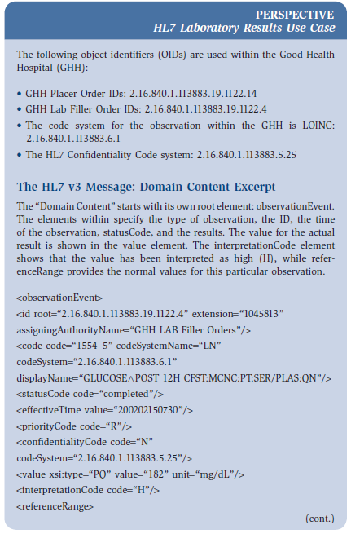
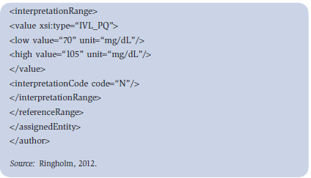
HL7 Use Case

Slide 23
DICOM
Digital Imaging and Communications in Medicine
American College of Radiology (ACR) and the National Electrical Manufacturers Association (NEMA) published the first standard in 1985
Purpose is to achieve compatibility and to improve workflow efficiency between imaging systems and other information systems in healthcare environments worldwide

Slide 24
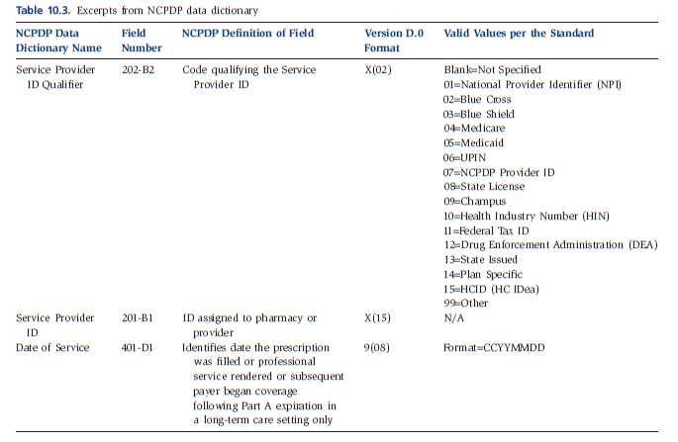
NCPDP
National Council for Prescription Drug Programs
ANSI-accredited SDO with over 1,600 members representing the pharmacy services industry
developed a set of standards for the electronic submission of third-party drug claims

Slide 25
ASC X12N Standards
ANSI Accredited Standards Committee (ASC) X12 develops standards, in both X12 and XML formats, for the electronic exchange of business information
Its subcommittee, X12N, has been specifically designated to deal with electronic data interchange (EDI) standards in the insurance industry, and
X12N has a special health care task group, known as TG2.
HIPAA covered entities are required to be compliant with the ASC X12 version 5010

Slide 26
TG2 Work Groups
Work Group Number | Work Group Name
WG1 | Health Care Eligibility
WG2 | Health Care Claims
WG3 | Claim Payments
WG4 | Enrollments
WG5 | Claims Status
WG9 | Patient Information
WG10 | Health Care Services Review
WG15 | Provider Information
WG20 | Insurance—824 Implementation Guide
WG21 | Health Care Regulation Advisory/Collaboration

Slide 27
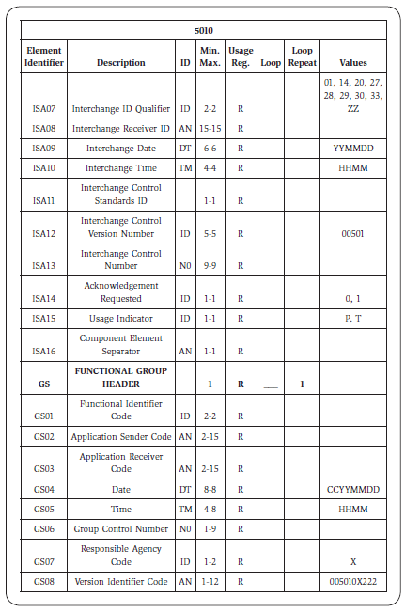
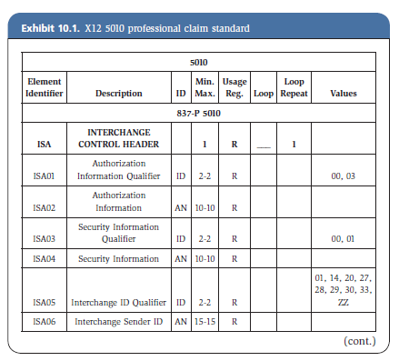
X12 5010 Professional Claim Form

Slide 28
Health Record Content and Functional Standards
HL7 EHR-S (Electronic Health Record-System) Functional Model
ASTM Health Record Content Standards
Continuity of Care Document
HITECH EHR Certification Criteria

Slide 29
HL7 HER-S Functional Model
HL7 Health Record-System (EHR-S) Functional Model
recognized by the ISO as an international standard (ISO 10781)
purpose is to outline important features and functions that should be contained in an EHR

Slide 30
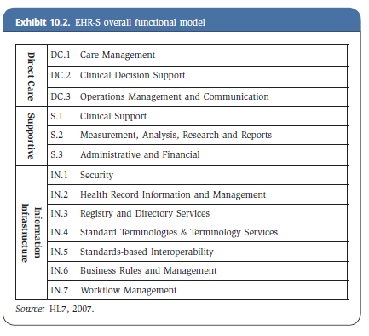
HL7 HER-S Functional Model

Slide 31
ASTM Health Record Content Standard
ASTM Committee E31 has developed several standards
E2369, Specification for Continuity of Care Record (CCR), which defines a core set of information to be sent to a health care provider when a patient is referred or transferred.
E1384, Practice for Content and Structure of the Electronic Health Record (EHR), which provides a structure for data collected in patient care records, and
E1633, Specification for Coded Values Used in the Electronic Health Record, which provides detailed value sets for use with E1384.

Slide 32
CCD
Continuity of Care Document
merger of two other standards, the HL7 Clinical Document Architecture (CDA) standard and the ASTM CCR
outline for the CCD is as follows
Header
Purpose
Problems
Procedures
Family History
Social History
Payers
Advance Directives
Alerts
Medications
Immunizations
Medical equipment
Vital signs
Functional stats
Results
Encounters
Plan of care

Slide 33
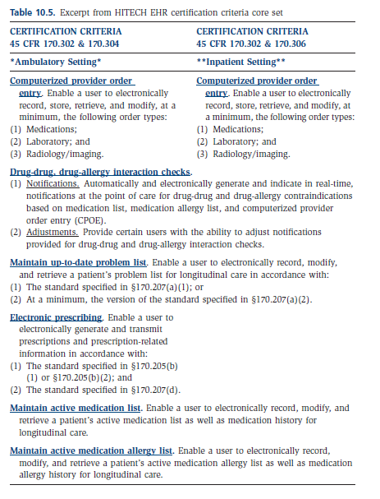
HITECH EHR Certification
To qualify for the HITECH incentive program, providers not only must insure “meaningful use” of the EHR, but must also demonstrate that the EHR in use meets certification criteria

Slide 34
Federal Initiatives Affecting Standards
HIPAA
CMS e-prescribing
Office of the National Coordinator for Health Information Technology
HITECH (discussed in Chapter six)

Slide 35
HIPAA
Rules for electronic transmissions
Designated standard maintenance organizations (DSMOs)
Accredited Standards Committee X12
Dental Content Committee of the American Dental Association
Health Level Seven
National Council for Prescription Drug Programs
National Uniform Billing Committee
National Uniform Claim Committee

Slide 36
HIPAA
Rules for electronic transmissions
Transaction Standards
ASC X12N version 5010
NCPDP
Standard Code Sets
HCPCS (ancillary services or procedures)
CPT-4 (physicians procedures)
CDT (dental terminology)
ICD-9 (ICD-10 as of October 2014 for diagnoses and hospital inpatient procedures)
NDC (national drug codes)

Slide 37
CMS e-Prescribing
CMS e-prescribing standards consist of three sets of existing health care IT standards as “foundation” standards
NCPDP’s SCRIPT Standard for e-Prescribing
ASC X12N standard for Health Care Eligibility Benefit and Response
NCPDP’s telecommunications standard

Slide 38
ONC
Office of the National Coordinator for Health Information Technology
principal Federal entity charged with coordination of nationwide efforts to implement and use the most advanced health information technology and the electronic exchange of health information

Slide 39
NwHIN
Nationwide Health Information Network
a set of standards, services, and policies that enable the secure exchange of health information over the Internet
currently twenty-five participating NwHIN organizations, including four federal agencies—CMS, DoD, SSA, and VA—and twenty-one private health care organizations

Slide 40
Summary
Standards Development Process
Standards that support Health Care Information System Interoperability
Classification Standards
Vocabulary and Terminology Standards
Health Record Content and Functional Standards

Slide 41
Summary
Federal Initiatives Affecting Standards
HIPAA
CMS e-prescribing
Office of the National Coordinator for Health Information Technology

