Slide 1
Chapter 12
Information Technology Resources

Slide 2
Learning Objectives
Describe the roles, responsibilities, and major functions of the IT dept or organization.
Discuss the role and responsibility of the CIO, CMIO, CSO, CTO, and other key IT staff.
Describe the different ways IT services might be organized and governed.
Identify key attributes of highly effective IT organizations.
Develop a plan for evaluating the effectiveness of the IT function within an organization.

Slide 3
Outline
Information Technology Functions
IT department responsibilities
Core functions
IT Senior Leadership Roles
Other IT Staff Roles
Recruitment and Retention of IT Staff
Organizing IT Staff and Services
Centralization vs Decentralization
Core IT competencies

Slide 4
Outline continued
In-House Vs Outsourced IT Services
Evaluating the Effectiveness of the IT Function
Governance
Budget development and resource allocation
System acquisition and implementation
IT Service levels

Slide 5
IT Responsibilities
IT plan and strategy are congruent with organization’s goals
Work with organization to acquire/develop and implement new applications
Provide day-to-day support

Slide 6
IT Responsibilities continued
Manage IT infrastructure—perform backups, install networks, print weekly paychecks, secure systems from virus attacks
Examine the role and relevance of emerging information technologies

Slide 7
Core Functions
Operations and Technical Support
Manage infrastructure—servers, networks, operating systems, database management systems and workstations.
Applications management—manages the process of acquiring, developing and implementing new applications
Specialized groups—research and development

Slide 8
Core Functions continued
IT Administration-
Oversee development of IT strategic plan
Develop and monitor the IT budget
Provide human resources support for the IT staff
Provide support for the management of projects
Manage space occupied by IT staff

Slide 9
IT Leadership
Chief Information Officer
Chief Technology Officer
Technical architecture
Track emerging technologies
Assess value of new technologies to organization

Slide 10
Characteristics of Effective CIOs

Slide 11
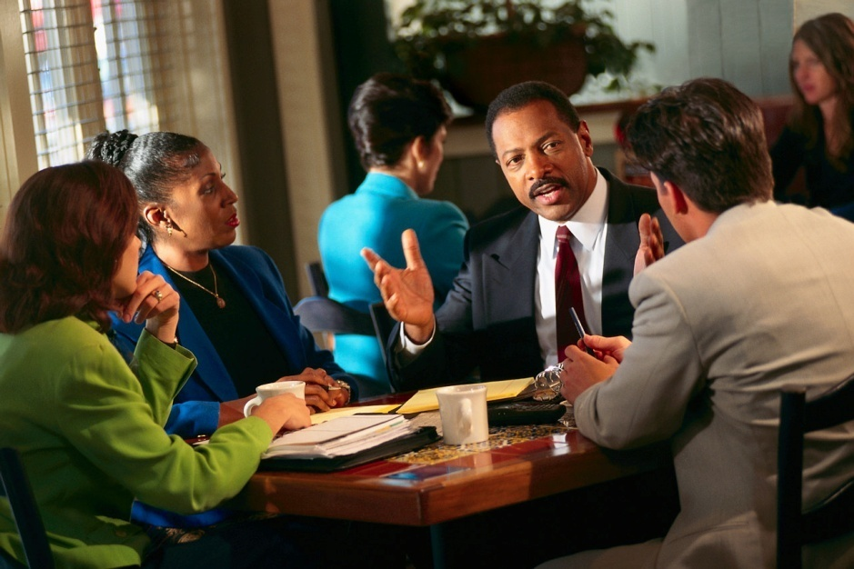
IT Leaders continued
Chief Medical Informatics Officer
Usually physician
Lead clinical information system initiatives
Establish clinical IT priorities
Chief Security Officer
Develop and institute security plan

Slide 12
Other IT Staff Roles
Systems Analyst
Work closely with end-users to assess needs, evaluate workflow, communicate needs to programmers.
Programmer
Write, test, and maintain programs; solve computer problems
Database administrator
Build and maintain databases

Slide 13
Other IT Staff Roles
Network administrator
Design, test, and evaluate networks (LANs,WANs, Internet, intranets, etc.) Make hardware and software recommendations
Telecommunication specialist
Manage organization’s telephone systems, call systems, communications network in event of disaster.

Slide 14
Other IT Staff Roles
Webmasters—responsible for all technical aspects of Web site, including performance issues, speed, and content of site.
Web developers-responsible for the day to day site design and creation.

Slide 15
Staff Attributes
Execute well – deliver on time, on budget, good impression
Good consultants-advise on best approach
Provide world-class support
Keep expertise current

Slide 16
Organizing IT Staff
Job function or service area (e.g., communications unit, research and development unit)
Specialized skill that can be applied to a wide range of projects
Product lines – set up as teams to develop, implement, maintain and support a particular application of suite of applications

Slide 17
Organizing IT Staff
Job function or service area (e.g., communications unit, research and development unit)
Specialized skill that can be applied to a wide range of projects
Product lines – set up as teams to develop, implement, maintain and support a particular application of suite of applications

Slide 18
Other approaches to organizing IT staff
Critical organizational processes—might have team that manage and provide IT services to support patient revenue cycle or patient access or medical services. Staff learn all IS associated with cross-organizational process.
Centralized versus decentralized?

Slide 19
Example of IT Organization Chart

Slide 20
Discussion
IT services should be evaluated for their effectiveness and efficiency just like any other facility resource or service. Assume you were to devise a plan for assessing the effectiveness and efficiency of IT services within your healthcare organization. What would you do?

Slide 21
Summary
Critical that health care organizations have access to appropriate IT staff and resources to support HCIS and system users
IT Leadership team may include CIO, CTO, CMIO, CSO. Need to invest in IT people
Various factors influence how IT function may be organized & structured
Important to continually assess IT services

